Slide 1
DanVeer Food Donation app

Slide 2
Abstract
A food donation app is a digital platform created to streamline the process of food donation and connect restaurant owners, administrators, and non-governmental organizations (NGOs) in a collective effort to reduce food waste and help those in need. This abstract outlines the core features of the app and the interactions among the three primary user profiles: restaurant owner, admin, and NGO.
Restaurant Owner:
Restaurant owners play a pivotal role in the app, initiating the food donation process.
They have the ability to create food donation requests, specifying details about the surplus food they are willing to donate.
Admin:
Administrators oversee and manage the operational aspects of the app.
Admins maintain control over user accounts, ensuring the platform's smooth operation, and may perform various administrative tasks.
NGO:
NGOs are vital partners in the food donation process, acting as recipients of donated food.
They can view the food donation requests made by restaurant owners and have the option to accept and claim these requests for distribution.

Slide 3
Synopsis Title: DanVeer Food Donation App.
1. Introduction:
A food donation app is a digital platform created to streamline the process of food donation and connect restaurant owners, administrators, and non-governmental organizations (NGOs) in a collective effort to reduce food waste and help those in need.
2. Problem Definition:
The challenge is to efficiently connect restaurant owners willing to donate surplus food with NGOs seeking food donations, creating a platform where restaurant owners can make food requests, and NGOs can easily view and accept these requests, all while being managed and monitored by administrators.
3. Existing System:
The existing system lacks an efficient platform for connecting restaurant owners, NGOs, and administrators to facilitate surplus food donations. This inefficiency contributes to food waste and limits the ability to address food insecurity effectively.

Slide 4
4. Objective:
Efficient Connection: Facilitate a seamless connection between restaurant owners and NGOs to ensure surplus food is promptly donated to those in need.
User-Friendly Interface: Create a user-friendly platform that allows restaurant owners to request food donations while enabling NGOs to easily view and accept these requests
5. Purpose:
To efficiently bridge the gap between surplus food providers (restaurant owners) and those in need (NGOs), promoting responsible food donation and minimizing waste.
6. Scope:
The app will facilitate the efficient connection between restaurant owners, NGOs, and administrators for the streamlined donation of surplus food, ensuring transparency and minimizing food waste.
7. Applicability:
The app serves as a digital platform to foster food donation by connecting restaurant owners, administrators, and NGOs, streamlining the process of requesting and accepting food donations for the benefit of those in need.

Slide 5
8. Feasibility Study:
The application is mobile based which gives it an advantage of running on most of the devices.
It can be easily accessible through internet connection which is now easily available with no extra charges.
9 Planning and Scheduling
Phase 1: In phase 1 we will find the required tools necessary for completion of this project
Phase 2: In this phase we will make ERD, DFD and flowcharts
Phase 3: this is the most important phase where we will start programming using a version control system as this is a team effort.
Phase 4: We will test the application and make changes if needed.
10 Software and Hardware Requirements
Android Studio , Version control system(Git,Github)
Kotlin
Backend : Firebase

Slide 6
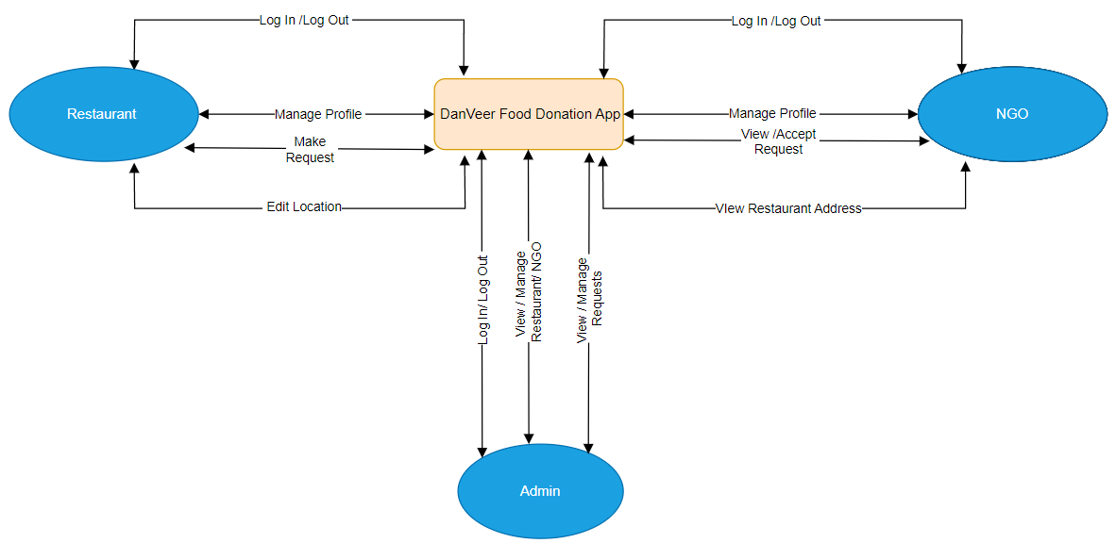
DFD LEVEL 0

Slide 7
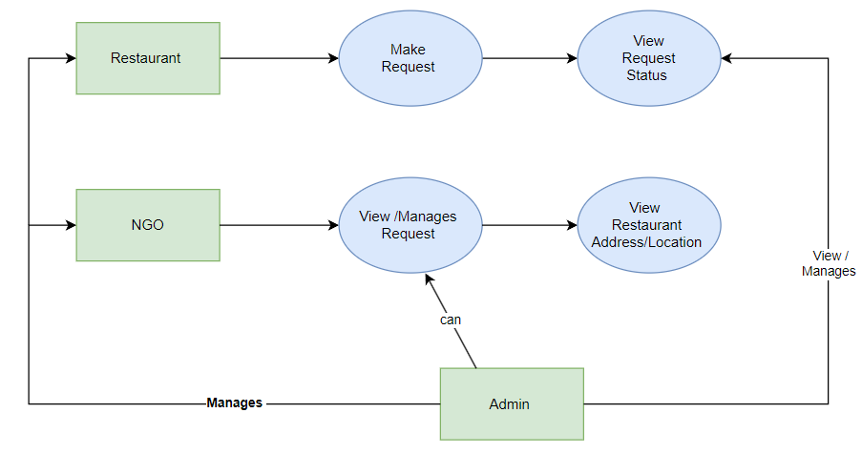
DFD LEVEL 1

Slide 8
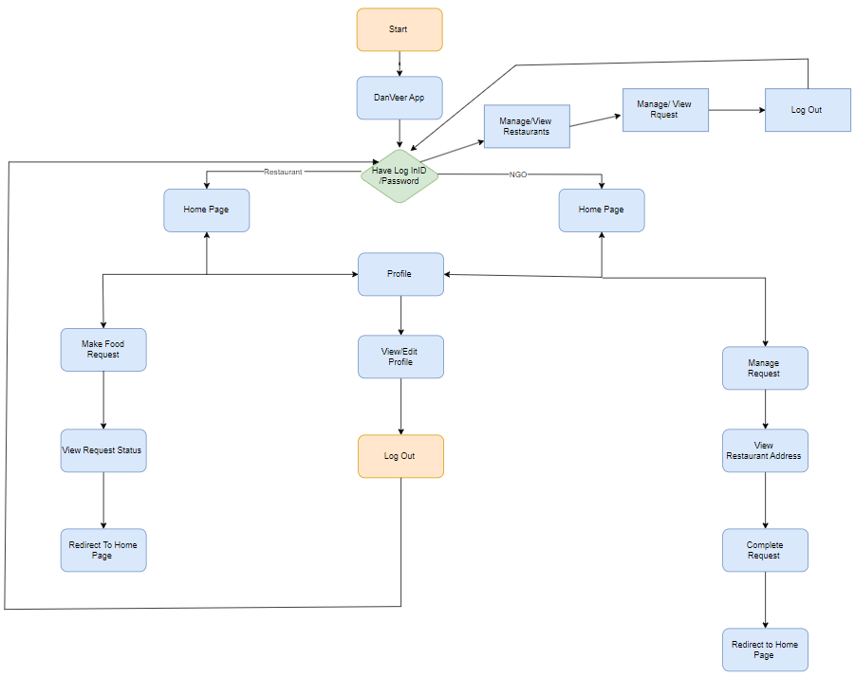
Flowchart

Slide 9
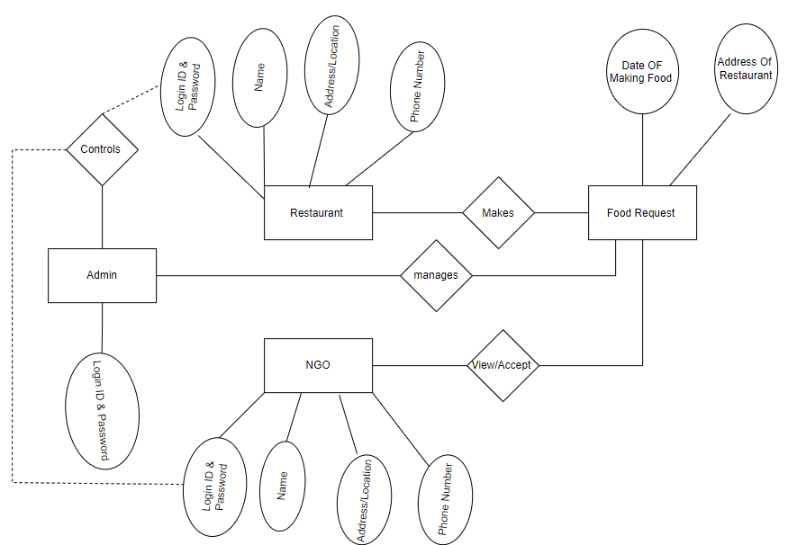
Entity-relationship Diagram

Slide 10
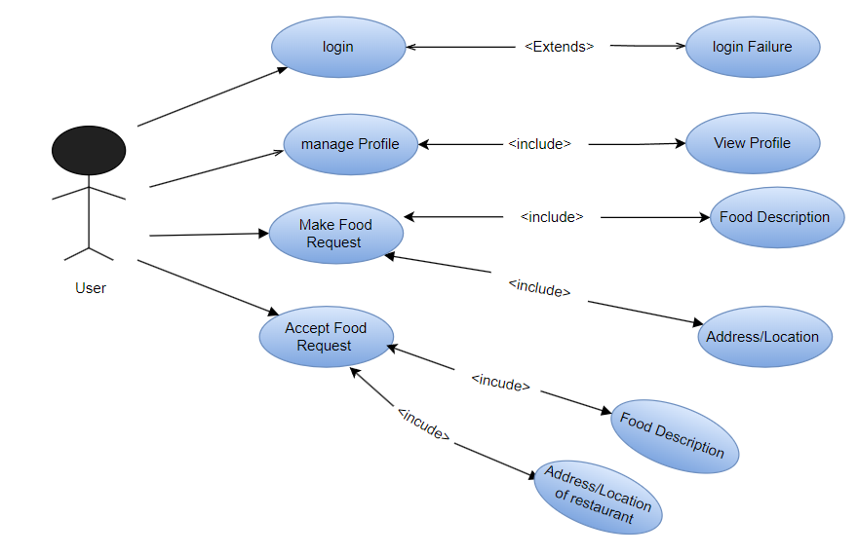
Use Case Diagram

